Slide 1
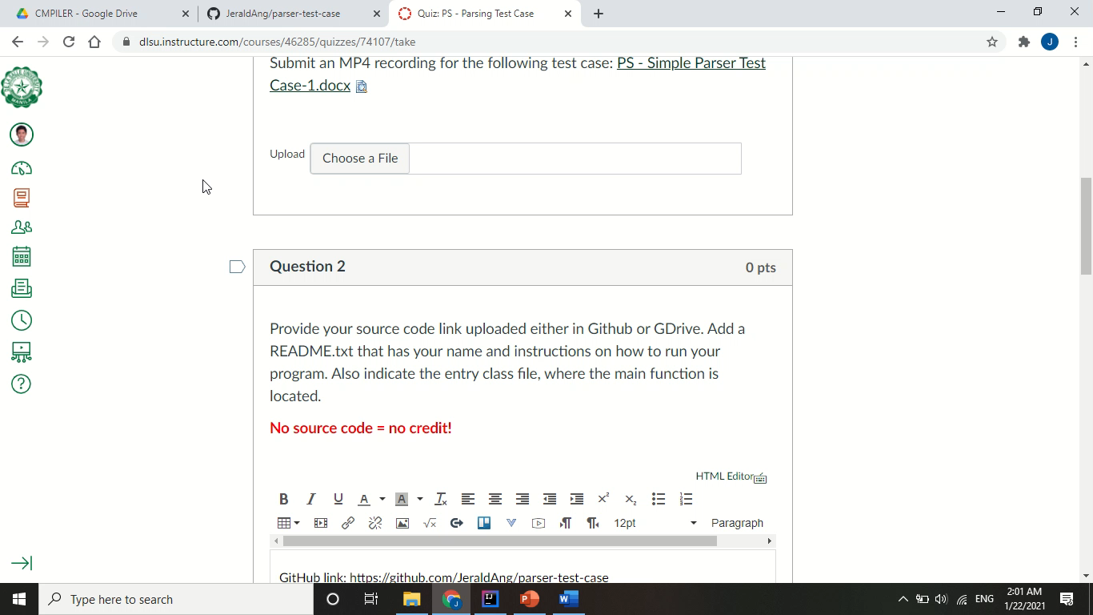
Ang, Jerald Edric D. S12

Slide 2
READING THE TEXT INPUT
How do you detect terminal symbols?
The text input is first read by the lexical analyzer, which creates token classes for each number, symbol, or invalid token (these are the terminal symbols).
Once the tokenList is created, the program passes this onto the parser per line, to enable error recovery.
The parser then determines whether the sequence of tokens is valid or not, by matching the input with the grammar file.

Slide 3
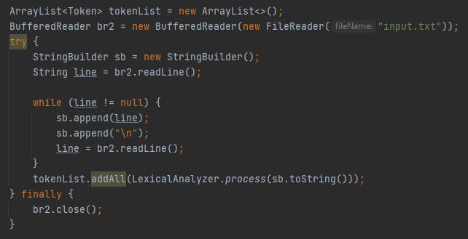
CODE SNIPPET: DETECTING TERMINAL SYMBOLS
Reading the input text file

Slide 4
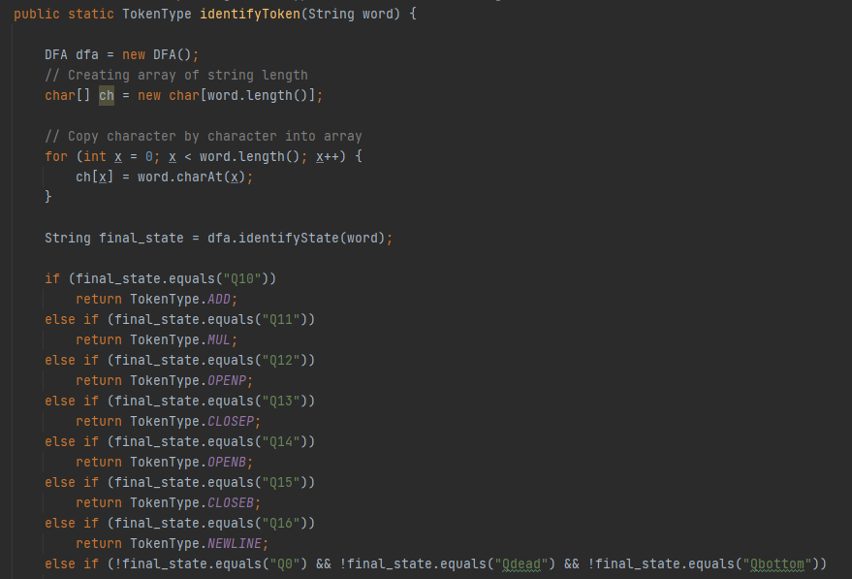
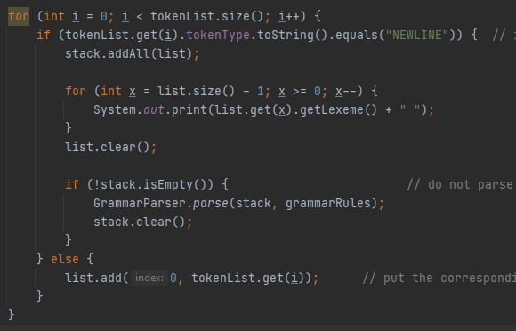
CODE SNIPPET: DETECTING TERMINAL SYMBOLS
DFA and tokenization process / using these tokens in Main class

Slide 5
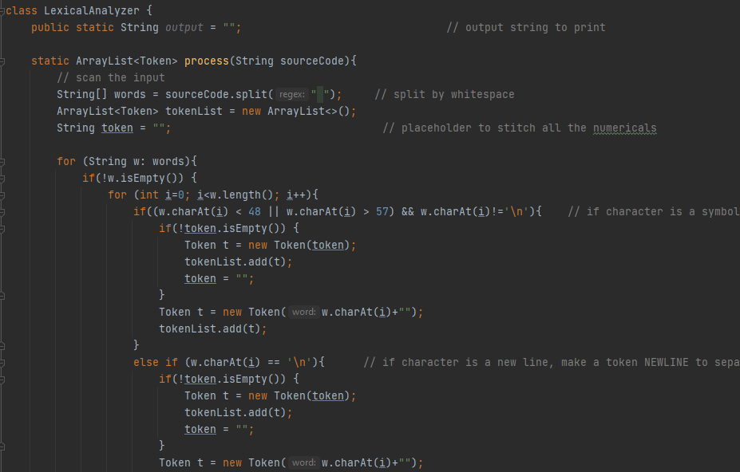
CODE SNIPPET: DETECTING TERMINAL SYMBOLS
Lexical Analyzer / Scanner class snippet for creating tokens

Slide 6
GRAMMAR RULES
How do you read your grammar file?
The grammar rules are read through a text file “grammar.txt”. Here, the LHS and RHS is separated by the colon symbol ( : ). The RHS is structured as a list of Strings, as a non-terminal can have multiple productions, separated by the | symbol.
Each non-terminal will be saved as their own “Rule” class, which will then be called by the parser by using a HashMap. The label or key for this hashmap is the LHS of the production.

Slide 7
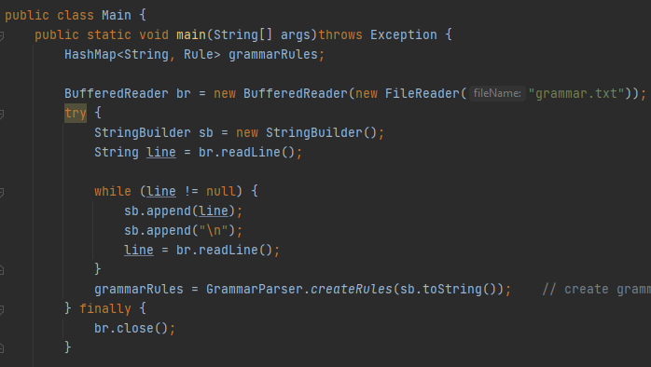
CODE SNIPPET: READING THE GRAMMAR FILE
Reading from the text file found inside the Main class

Slide 8
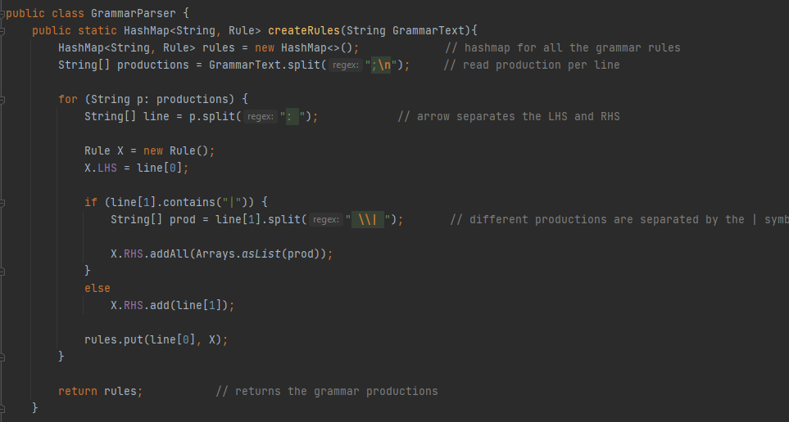
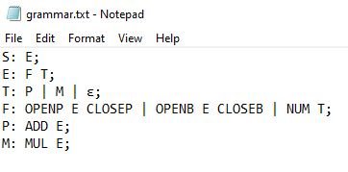
CODE SNIPPET: READING THE GRAMMAR FILE
This class converts the grammar text file into usable Rule classes for the “rulesMap” HashMap

Slide 9
IMPLEMENTATION OF RECURSIVE-DESCENT PARSER
I implemented this process by saving the previous input stack and production stack separately. When the input does not match a production, the current stacks will be overwritten to their previous versions, and a rule counter for the non-terminal is incremented to signify that the program should go to the next rule instead. If this counter reaches the total production count (last production), the parent non-terminal in the previous stack is read. This is done until a match is found, or until the history reaches the start state.
The recursive-descent parser requires checking all the possible productions until the correct sequence is found. If there are no such combinations, this is considered an error. One important aspect of this parsing is the backtracking process, allowing the parser to go back and test another production of a non-terminal in the stack.

Slide 10
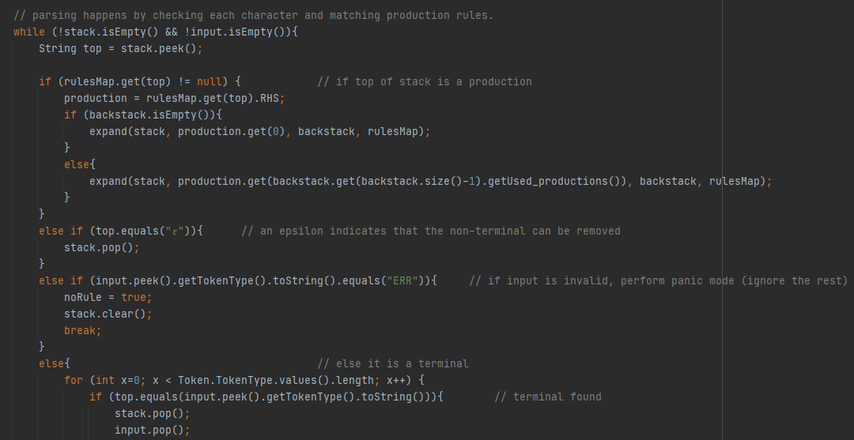
CODE SNIPPET: RECURSIVE-DESCENT PARSER
Detecting non-terminals, terminals, epsilon and error

Slide 11
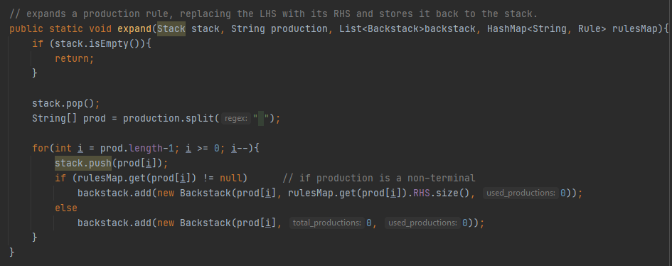
CODE SNIPPET: RECURSIVE-DESCENT PARSER
Expand class that converts LHS in a stack to its selected RHS

Slide 12
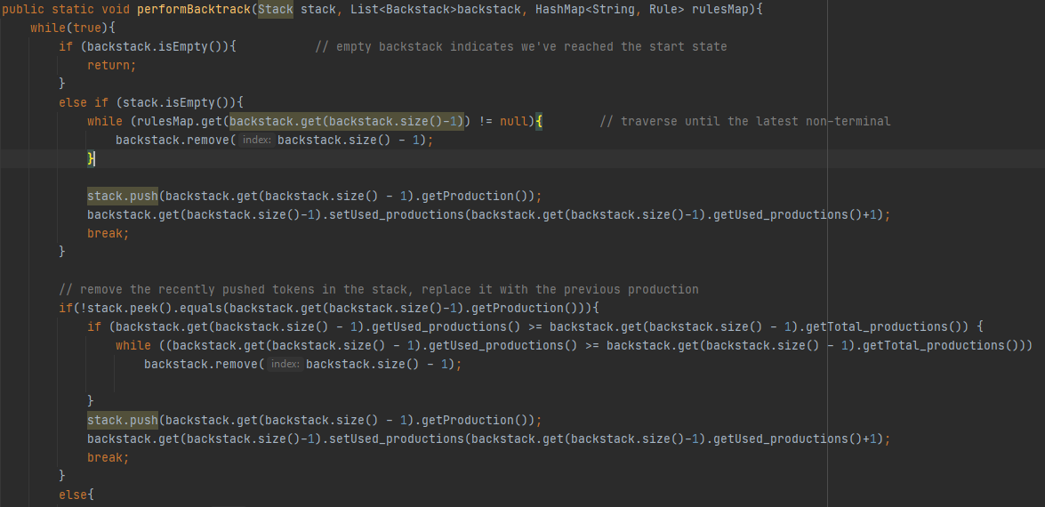
CODE SNIPPET: RECURSIVE-DESCENT PARSER
Snippet of the backtracking class

Slide 13
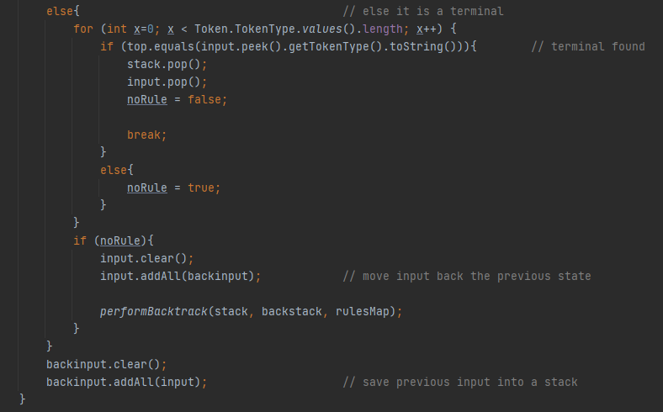
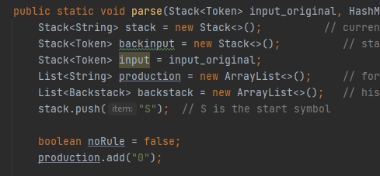
CODE SNIPPET: RECURSIVE-DESCENT PARSER
Call backtracking when the input does not match production. Use separate stacks.

Slide 14
PARSING ERRORS
How do you recover from parsing errors?
The type of error recovery that this test case requires is the “panic mode” recovery. When an invalid token placement or symbol is found, the parser prints this to the output and ignores the preceding tokens until a delimiter (in this case a new line) is detected.
For an incorrect sequence, a boolean noRule is checked after backtracking all possible productions. Since the scanner class feeds the parser class per line, the parser will simply get the offending token, then disregards the rest of the input. The succeeding lines will not be affected as this is a new function call to the Parser class.

Slide 15
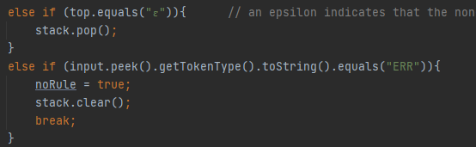
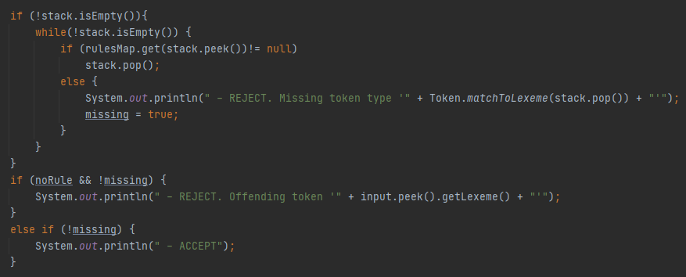
CODE SNIPPET: PARSING ERROR RECOVERY
Break loop once an error occurs. Print the offending token.

